Slide 1
HYPERTEXT MARKUP LANGUAGE
HTML

Slide 2
AGENDA

Slide 3
Agenda
Introduction to HTML and its Ecosystem(Tags and attributes)
Boilerplate code
Headings, Lists , Paragraphs
Hyperlinks
Images
Block vs inline
Whitespace and Character Entities
Structuring files
Container Elements
Tables
Forms

Slide 4

WEB PAGE
A web page is an electronic document. They are files that are stored on a computer that runs software called a web server and retrieve via a program called a browser.

Slide 5
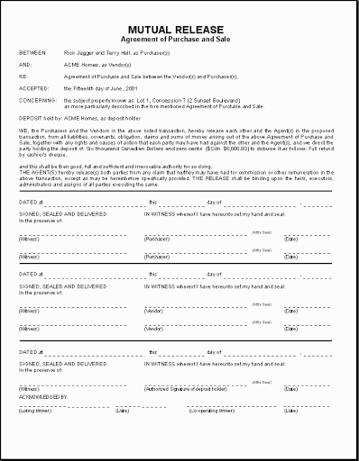
A PHYSICAL DOCUMENT

Slide 6
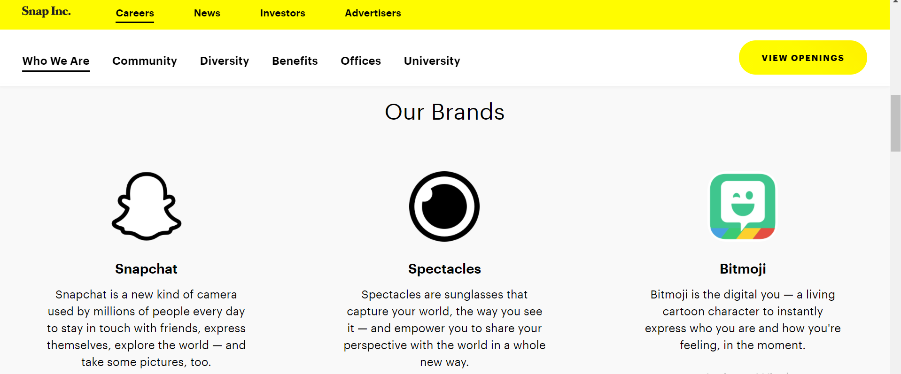
WEB PAGE

Slide 7
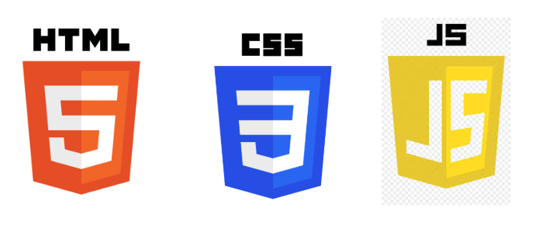
MAIN FRONT-END TECHNOLOGIES

Slide 8
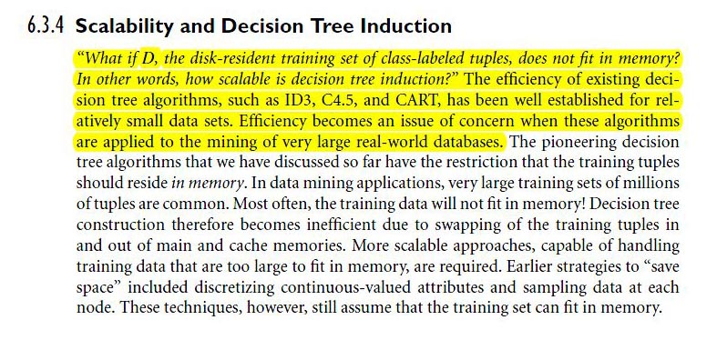
EXAMPLE OF HOW YOU MARKUP TEXT
To the right is an example of marked up text.
Parts of the paragraphs is highlighted. This is to note that the said text is important and have special meaning.
HTML does the same. It “marks up text”, give meaning to text. It does this via tags.

Slide 9
HTML
HTML stands for Hypertext Markup Language. It is the standard markup language for documents designed to be displayed in a web browser
Its purpose to set the structure of a web page .

Slide 10
ECOSYSTEM OF HTML

Slide 11
TAGS

Slide 12
Tags
Tags are keywords enclosed in <> brackets.
Tags usually come in pairs. For said tags, there is an open tag and a closed tag.
Example : <tagname>Text</tagname>
Tags that don’t come in pairs are called self closing or empty tags
Example : <tagname>
HTML is a case insensitive language thus, tags can be written in lowercase or uppercase or mixed case. However, tags can be

Slide 13
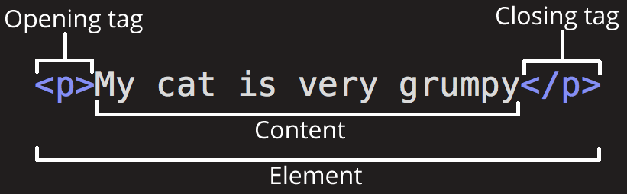
THE ANATOMY OF A TAG

Slide 14
ATTRIBUTES

Slide 15
Attributes
In addition to tags, another major component of HTML is Attributes
Attributes provide additional information about an element
Attributes are always specified in the start tag
Attributes usually come in name/value pairs like: name="value"
All HTML elements can have attributes
Some attributes can only be used on specific elements
Example of HTML Attributes :

Slide 16
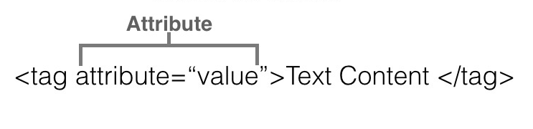
HOW TO ASSIGN ATTRIBUTES TO ELEMENTS

Slide 17
COMMENTS

Slide 18
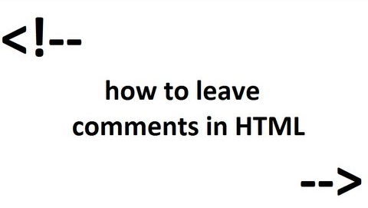
COMMENTS

Slide 19
BOILERPLATE CODE

Slide 20
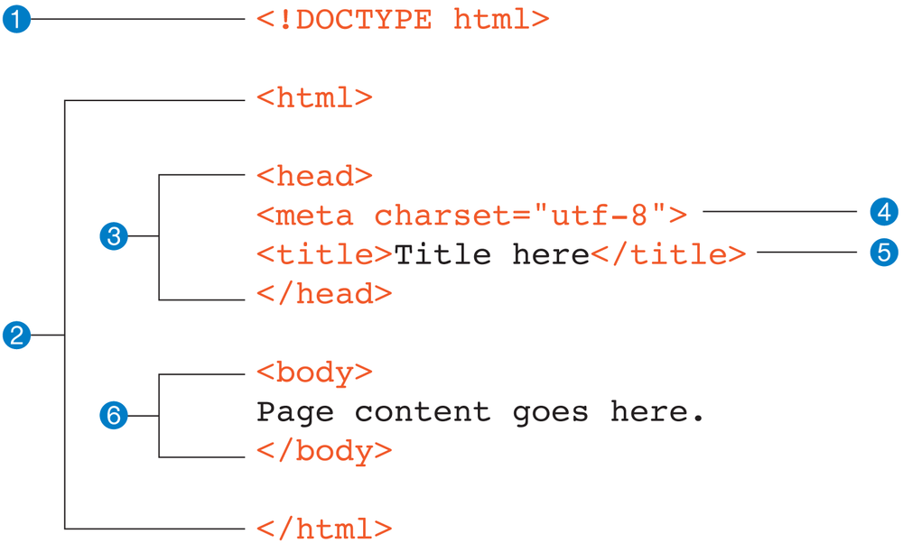
Skelton Code that every page requires

Slide 21
HEADINGS

Slide 22
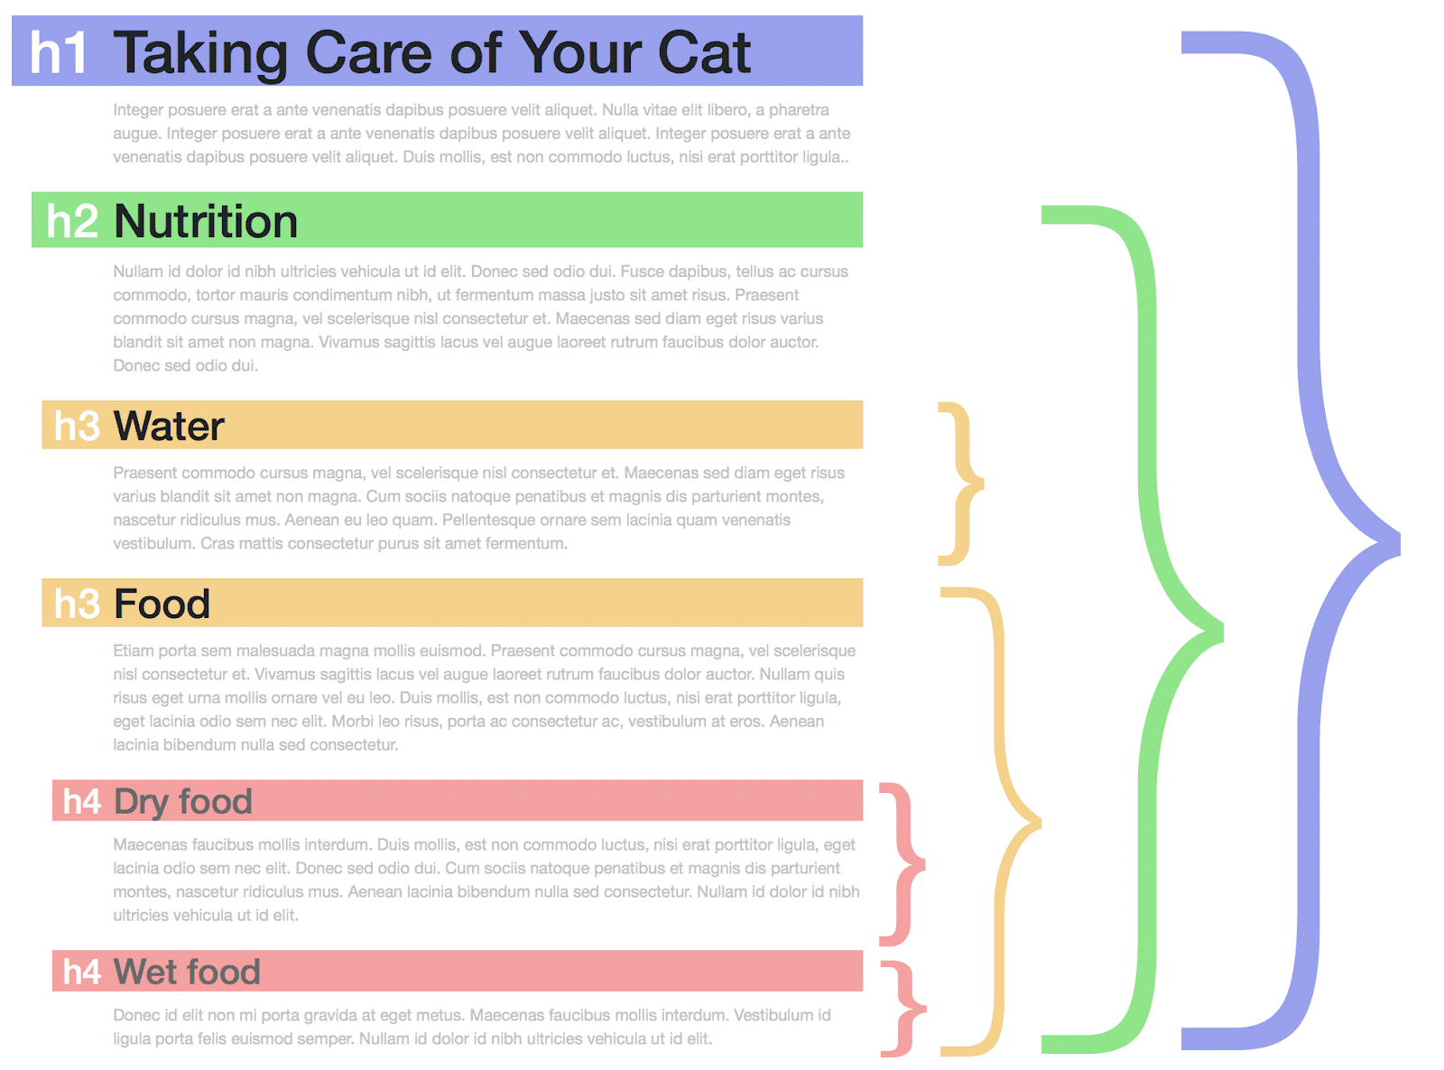

Slide 23
Headings
There are six heading elements — <h1>, <h2>, <h3>, <h4>, <h5>, and <h6>.
Each element represents a different level of content in the document;
<h1> represents the main heading
<h2> represents subheadings, <h3> represents sub-subheadings, and so on up until <h6>

Slide 24
PARAGRAPHS

Slide 25
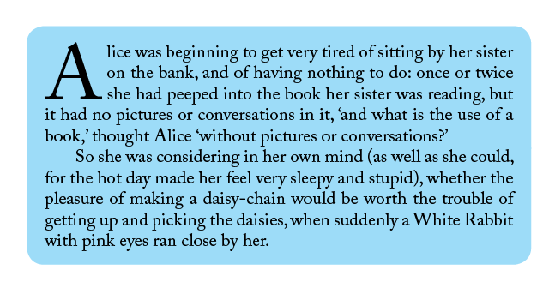
Paragraphs
In HTML, each paragraph has to be wrapped in a <p> element.

Slide 26
LISTS

Slide 27


Slide 28
Lists
Like real physical lists there are lists on web pages as well.
HTML supports two major types of lists:
Ordered List -Ordered lists are lists in which the order of the items does matter.

Slide 29
Lab 1 (Question 1)
https://docs.google.com/document/d/1FvlC0aJ4gclGQhM5VEKnhZUWauWUxYEuKeEr5eW6eos/edit?usp=sharing

Slide 30

HYPERLINKS

Slide 31
Hyperlinks
Hyperlinks allow us to link our documents to any other document (or other resource)
We can also link to specific parts of documents.
A link is created by wrapping the text (or other images) inside an <a> element, and giving it an href attribute (also known as a Hypertext Reference )that will contain the web address you want the link to point to.
Example

Slide 32
Absolute vs Relative URLs
An absolute URL points to a location defined by its absolute location on the web, including protocol and domain name.
Example, if an about.html page is uploaded to a directory called html that sits inside the root of a web server, and the web site's domain is http://www.mywebpage.com, the page would be available at : http://www.mywebpage.com/html/about.html
An absolute URL will always point to the same location, no matter where it is used.
Relative URL points to a location that is relative to the file you are linking from
For example, if we wanted to link to about about.html from the home page then the address would be file at html/about.html

Slide 33
Link Best Practices
Always make sure your links are accessible to all readers, regardless of their current context and which tools they prefer.
For example:
Screen Reader users like jumping around from link to link on the page, and reading links out of context.
Search engines use link text to index target files, so it is a good idea to include keywords in your link text to effectively describe what is being linked to.
Visual readers skim over the page rather than reading every word, and their eyes will be drawn to page features that stand out, like links. They will find descriptive link text useful.

Slide 34
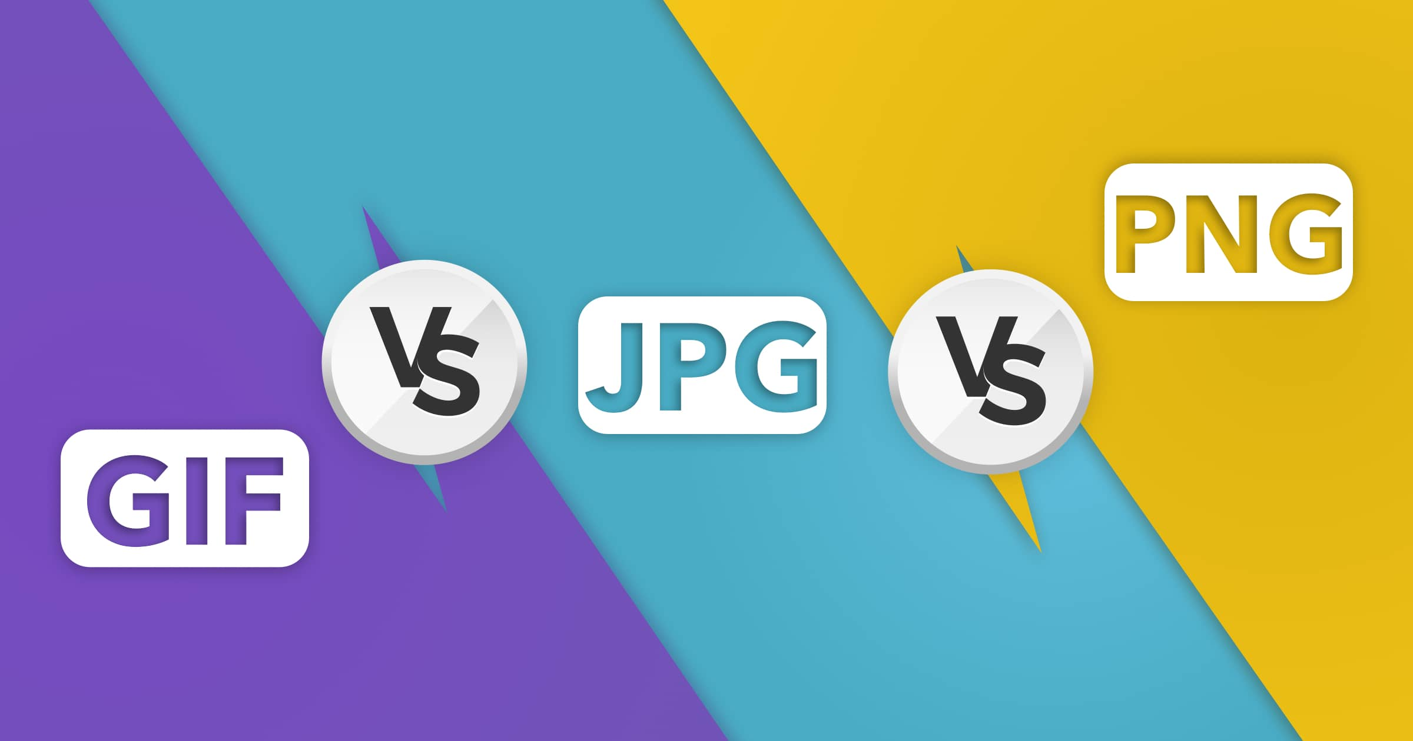
IMAGES

Slide 35
Image
To put a simple image on a webpage, we use the <img> element.
This is an empty element
The <img> element requires a minimum of one attribute to be useful src.
The src attribute contains a path pointing to the image you want to embed in the page,
Another attribute that you should use is (alt) Alternative text. This attribute can be used for user is visually impaired, and is using a screen reader to read the web out to them.

Slide 36
BLOCK VS INLINE ELEMENTS

Slide 37
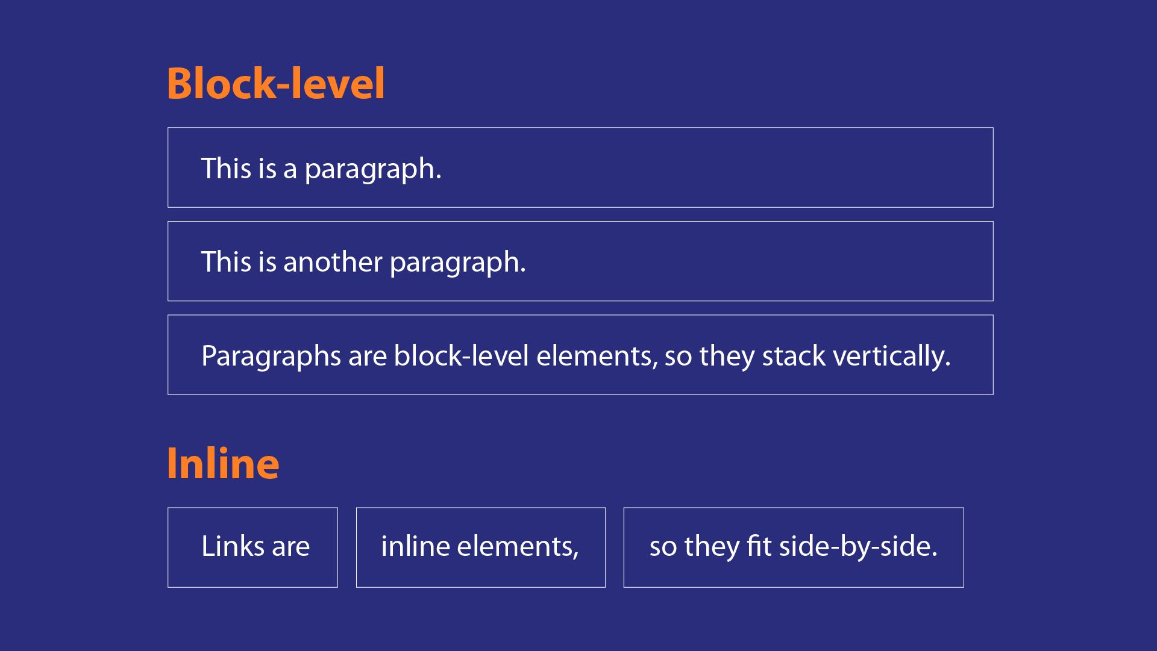

Slide 38
Block vs Inline level element
Block-level elements form a visible block on a page and take up 100% of it’s parent element thus forcing a new line from whatever content went before it, and any content that goes after it will also appear on a new line.
Block-level elements tend to be structural elements on the page that represent, for example, paragraphs, lists, navigation menus, footers, and so on.
A block-level element wouldn't be nested inside an inline element, but it might be nested inside another block-level element.
Inline elements are those that are contained within block-level elements and surround only small parts of the document’s content, not entire paragraphs and groupings of content.
An inline element will not cause a new line to appear in the document; they would normally appear inside a paragraph of text, for example an <a> element or <em> or <strong>.

Slide 39
WHITE SPACE AND HTML

Slide 40
White Space
No matter how much whitespace you use, the Browser reduces each one down to a single space when rendering the code.
The purpose of multiple whitespace is to make your your code easier to understand and read.
Ensure that it is nicely formatted, and not just bunched up together.

Slide 41
CHARACTER ENTITIES

Slide 42
Character Entities or Reference
In HTML, the characters <, >,",' and & are special characters.
Because they are part of the HTML syntax, if you have to include one of these characters in your text it can confuse the browser.
To use those special we have to user character references, that is, special codes that represent characters, and can be used in these exact circumstances. Each character reference is started with an ampersand (&), and ended by a semicolon (;).
Example:
Literal Character | Character Entities
< | &lt;
> | &gt;
& | &amp;
“ | &quote;
space | &nbsp;

Slide 43

FONTAWESOME

Slide 44
FONT AWESOME
Font Awesome is a font and icon toolkit based on CSS and Less.
https://fontawesome.com/

Slide 45
Lab 1 (Question 2 & 3)
https://docs.google.com/document/d/1FvlC0aJ4gclGQhM5VEKnhZUWauWUxYEuKeEr5eW6eos/edit?usp=sharing

Slide 46
STRUCTURING YOUR FILES

Slide 47
WHAT IS A CONTAINER?

Slide 48
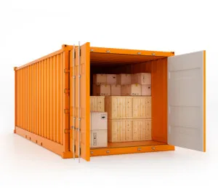
A container is an object that is used to hold other objects,usually for transport

Slide 49
CONTAINER ELEMENTS
HTML provides a set of container elements that are used to contain an unspecified set of other elements.

Slide 50
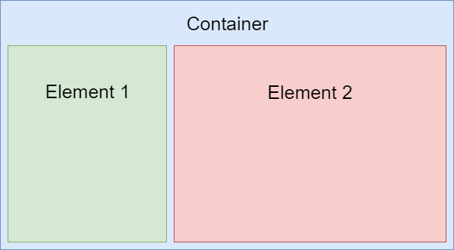

Slide 51
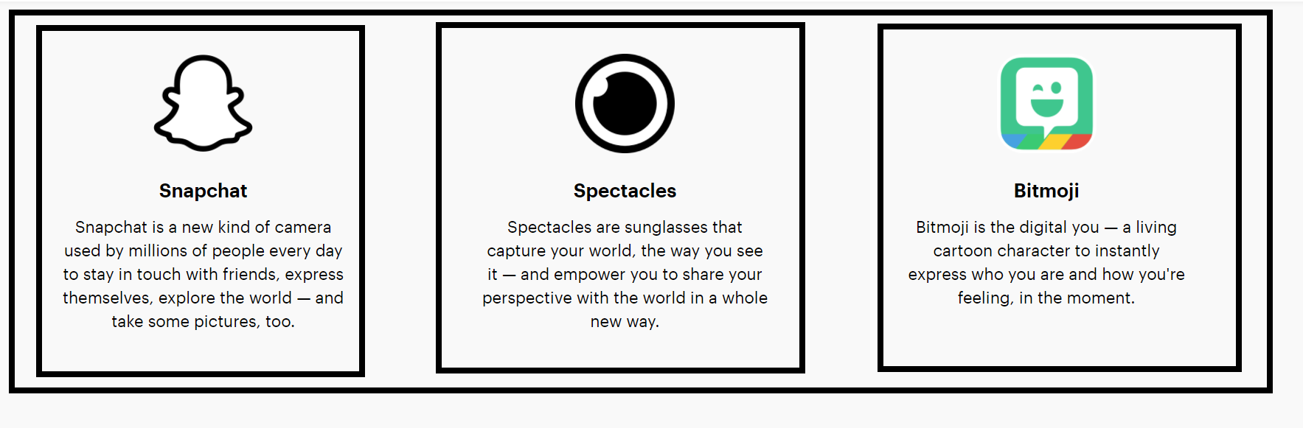

Slide 52
SEMANTIC CONTAINERS
VS
NON SEMANTIC CONTAINERS

Slide 53

WHAT DOES THE WORD SEMANTIC MEAN?

Slide 54

Semantics is the study of meaning

Slide 55
Container Elements
A semantic container clearly describes its meaning to both the browser and the developer.
header
footer
nav
section
article
aside
main
A non-semantic container - Tells you nothing about the content
div
span

Slide 56
SEMANTIC CONTAINERS:
Can be used to define different parts of a web page and used for structuring your webpage

Slide 57
STRUCTURING YOUR WEBPAGE
INTO SECTIONS

Slide 58
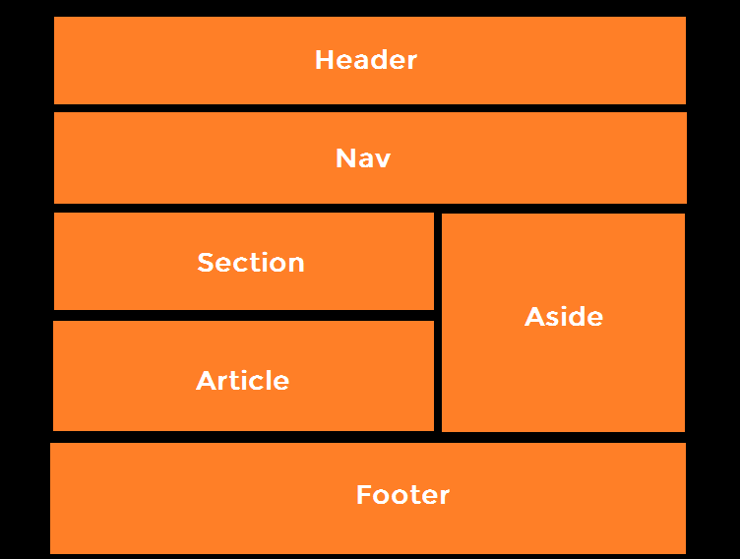

Slide 59
<header> </header>
Usually a big strip across the top with a big heading and/or logo and sometimes the navigation bar.. This is where the main common information about a website usually stays from one webpage to another

Slide 60
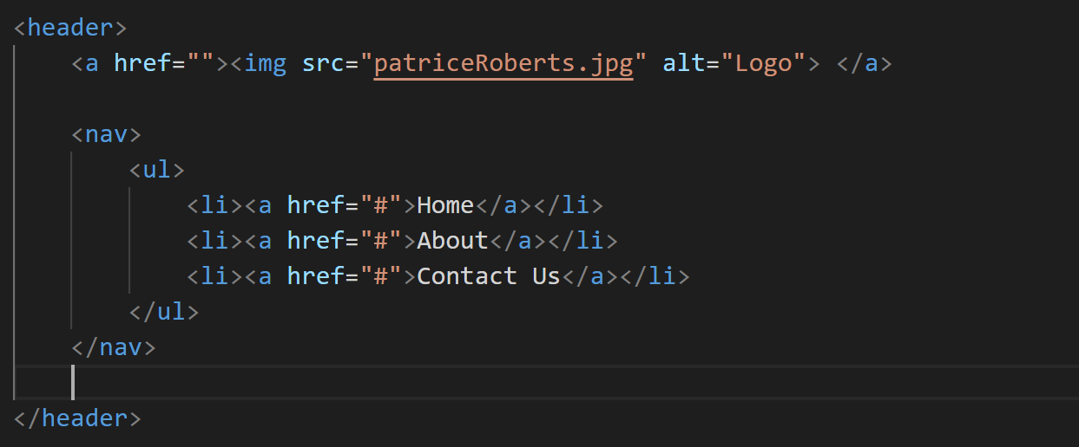

Slide 61
<footer> </footer>
A strip across the bottom of the page that generally contains fine print, copyright notices, or contact info. It's a place to put common information (like the header)

Slide 62
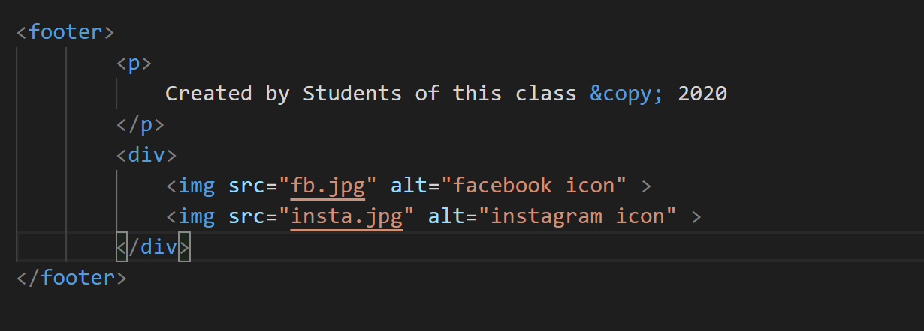

Slide 63
<nav> </nav>
This element is used to create the markup that defines the page navigation. In this we typically add an ul or ol list

Slide 64
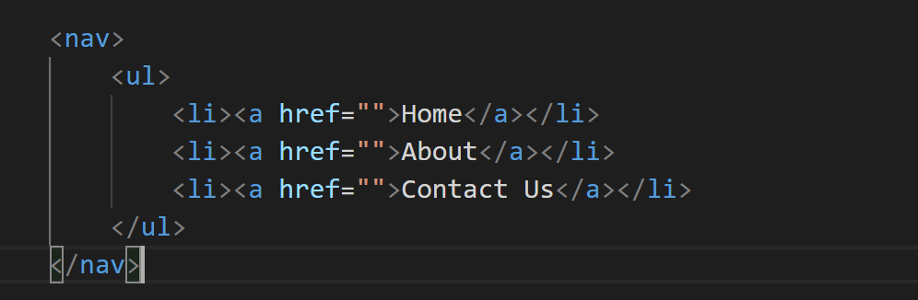

Slide 65
<section> </section>
Represents a section of a document. Each section has a heading tag (h1-h6), then the section body.

Slide 66
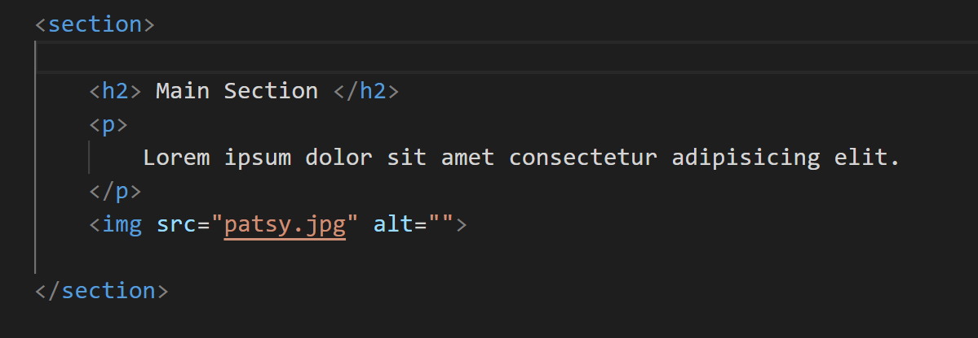

Slide 67
<article> </article>
The article tag identifies a thing that can be independent from other things in a page.
For example a list of blog posts in the homepage.

Slide 68
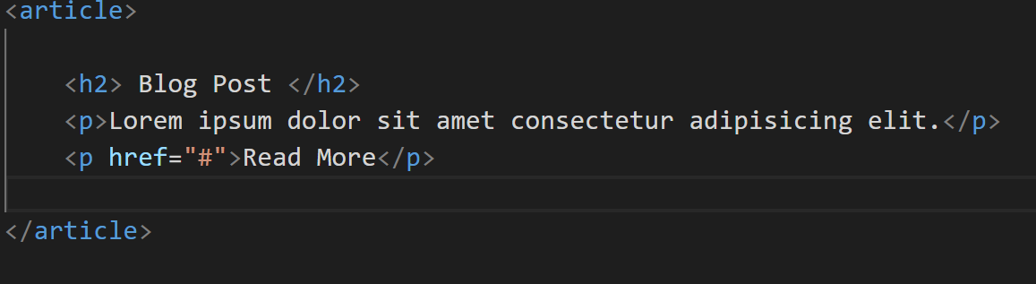

Slide 69
<main> </main>
A big area in the center that contains most of the unique content of a given webpage, for example, the video you want to watch, or the main story you're reading, or the map you want to view, or the news headlines, etc. This is the one part of the website that definitely will vary from page to page!

Slide 70
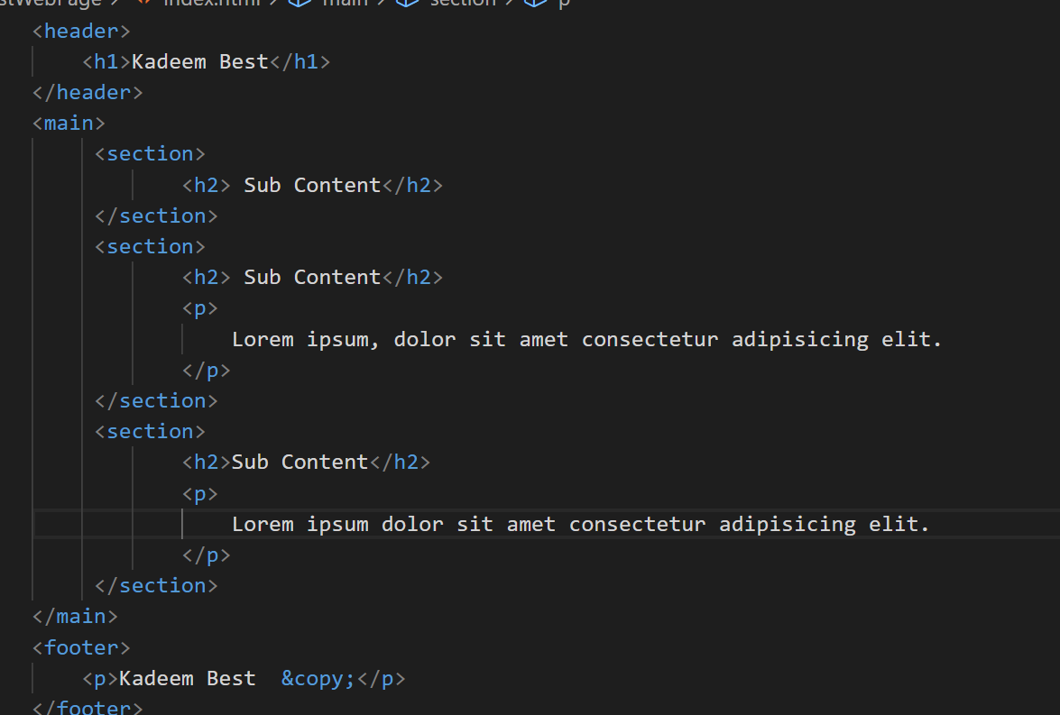

Slide 71
<aside> </aside>
The <aside> element defines some content aside from the content it is placed in (like a sidebar).
The <aside> content should be indirectly related to the surrounding content.

Slide 72
NON SEMANTIC CONTAINERS:
Used to group and hold other containers in a generic context

Slide 73
<div> </div>
The div element is the generic container element.We use div in any place where we need a container but the existing tags are not suited.

Slide 74
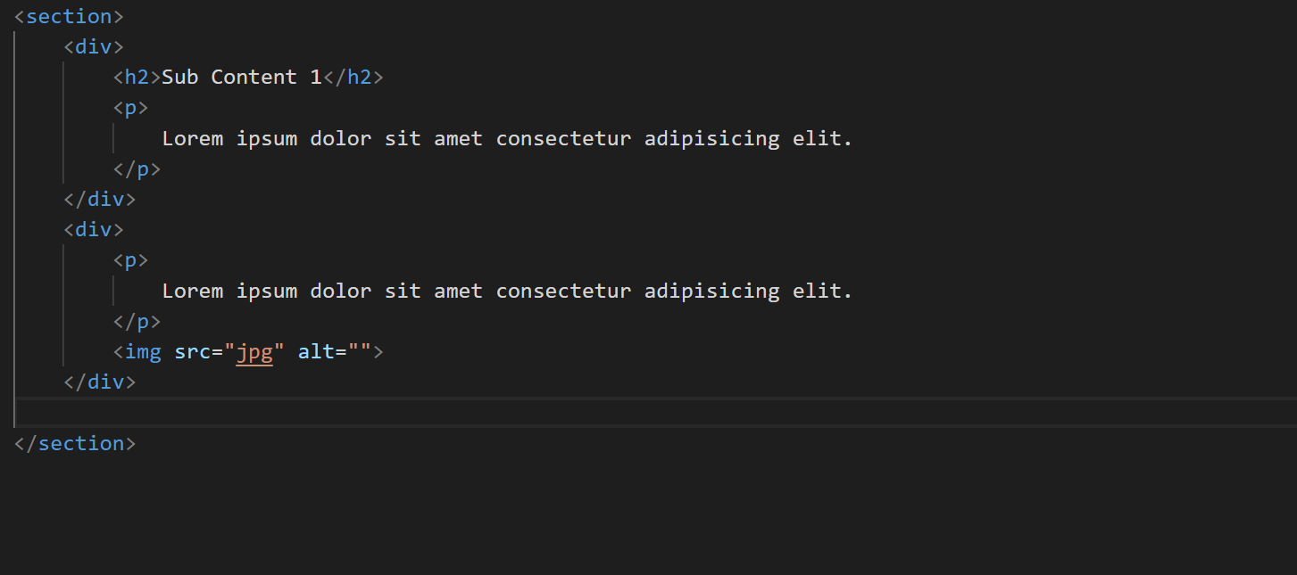

Slide 75
<span> </span>
The <span> tag is an inline container used to mark up a part of a text, or a part of a document. The <span> tag is easily styled by CSS

Slide 76
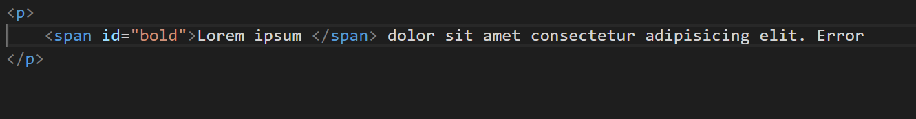

Slide 77
Container Exercise
Write the Markup Code for the following Web page

Slide 78
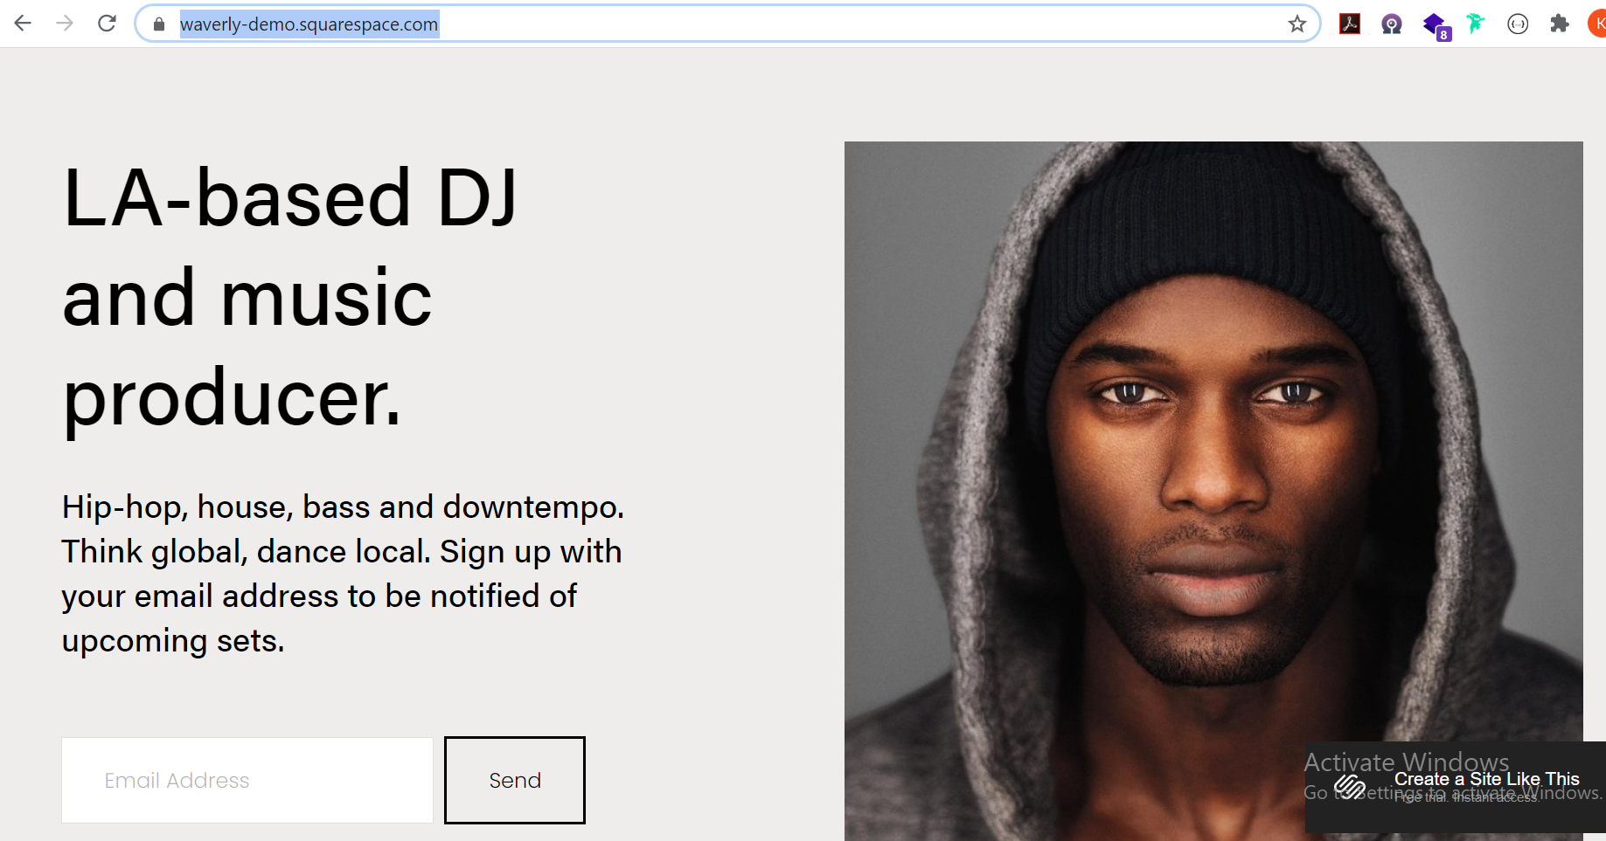
https://waverly-demo.squarespace.com/

Slide 79
TABLES
The HTML <table> element represents tabular data, that is, information presented in a two-dimensional table comprised of rows and columns of cells containing data.

Slide 80
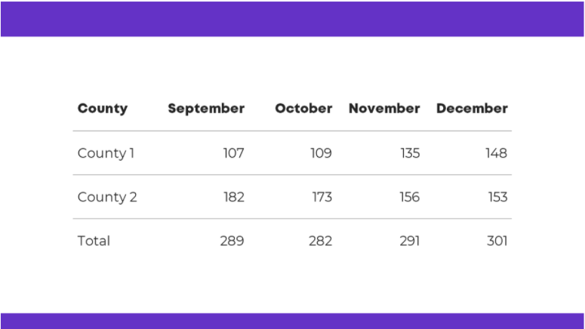

Slide 81
TABLES
The HTML <table> element define a table
The HTML <thead> element defines a set of rows defining the head of the columns of the table.
The HTML <th> element defines a cell as header of a group of table cells.
The HTML <tr> element defines a row of cells in a table. The row's cells can then be established using a mix of <td> (data cell) and <th> (header cell) elements.
The HTML <td> element defines a cell of a table that contains data.
The HTML Table Body element (<tbody>) encapsulates a set of table rows (<tr> elements), indicating that they comprise the body of the table

Slide 82
TABLES
The HTML <tfoot> element defines a set of rows summarizing the columns of the table.
The HTML <caption> element specifies the caption (or title) of a table.

Slide 83
FORMS
Forms allow users to enter data, which is generally sent to a web server for processing and storage and it is made up of one or more form controls and labels

Slide 84
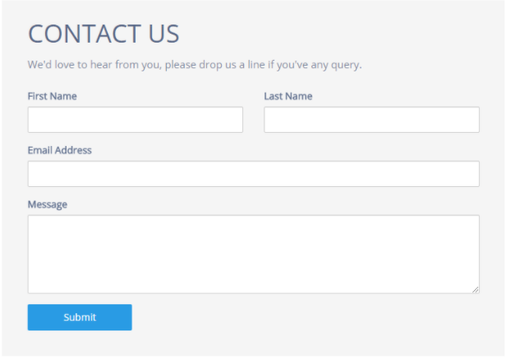

Slide 85
FORMS
The HTML <form> element represents a document section containing interactive controls for submitting information.
The following attributes control behavior during form submission :
action
The URL that processes the form submission.
method
The HTTP method to submit the form with. Possible (case insensitive) values:
post: The POST method; form data sent as the request body.
get: The GET method; form data appended to the action URL with a ? separator. Use this method when the form has no side-effects.

Slide 86
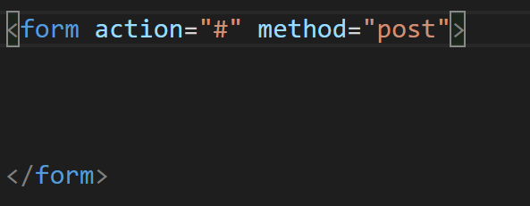
FORMS

Slide 87
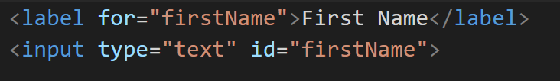
LABELS
The HTML <label> element represents a caption for an item in a user interface.

Slide 88
FORM CONTROLS(WIDGETS)
The HTML <form> element represents a document section containing interactive controls for submitting information.

Slide 89
TEXT INPUT FIELD
Text fields are the most basic form widgets. They are a very convenient way to let the user enter any kind of data

Slide 90
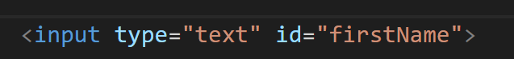
SINGLE LINE TEXT FIELD
A single line text field is created using an <input> element whose type attribute value is set to text, or by omitting the type attribute altogether (text is the default value).

Slide 91
MULTI LINE TEXT FIELD
The HTML <textarea> element represents a multi-line plain-text editing control, useful when you want to allow users to enter a sizeable amount of free-form text, for example a comment on a review or feedback form.

Slide 92
PASSWORD FIELD
The password value doesn't add any special constraints to the entered text, but it does obscure the value entered into the field (e.g. with dots or asterisks) so it can't be easily read by others.

Slide 93
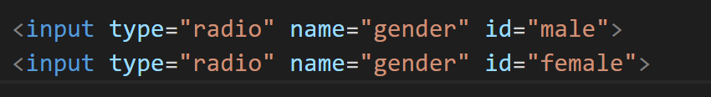
RADIO BUTTONS
A radio button is created using the <input> element with its type attribute set to the value radio.Several radio buttons can be tied together. If they share the same value for their name attribute, they will be considered to be in the same group of buttons. Only one button in a given group may be checked at a time; this means that when one of them is checked all the others automatically get unchecked.

Slide 94
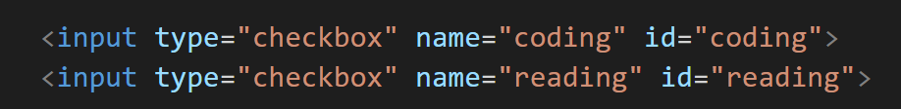
CHECKBOXES
A check box is created using the <input> element with a type attribute set to the value checkbox. A checkbox allows you to select single values for submission in a form (or not).

Slide 95
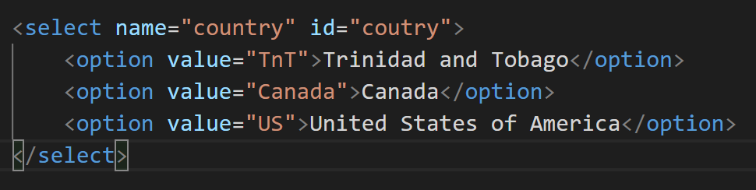
DROP DOWN LISTS
To create a drop down list that provides a menu of option, use the HTML <select> element

Slide 96
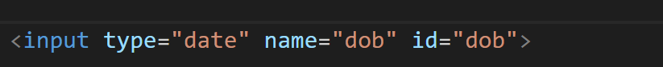
DATE PICKER
<input> elements of type="date" create input fields that let the user enter a date, either with a textbox that validates the input or a special date picker interface.

Slide 97
FILE PICKER
To create a file picker widget, you use the <input> element with its type attribute set to file. It allow you to choose which files (images, pdfs, documents) to send to the server.

Slide 98
ACTUAL BUTTONS
The radio button isn't actually a button, despite its name; let's move on and look at actual buttons! There are three input types that produce buttons:
Submit Button
Reset Button
Anonymous Button

Slide 99
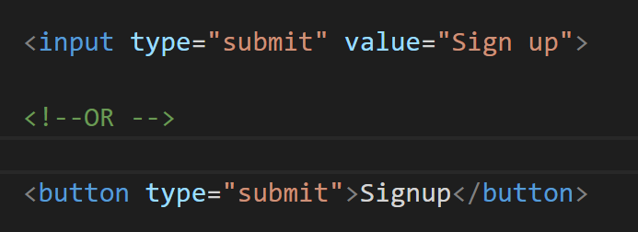
SUBMIT BUTTON
Sends the form data to the server.

Slide 100
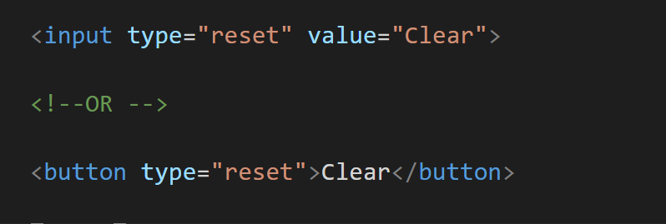
RESET BUTTON
Resets all form widgets to their default values.

Slide 101
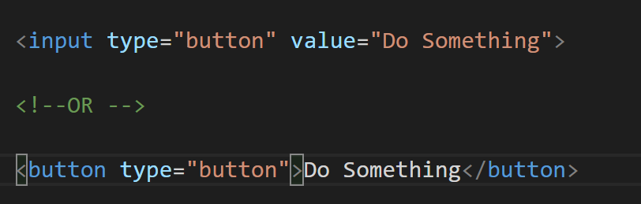
ANONYMOUS BUTTON
Buttons that have no automatic effect but can be customized using JavaScript code.

Slide 102
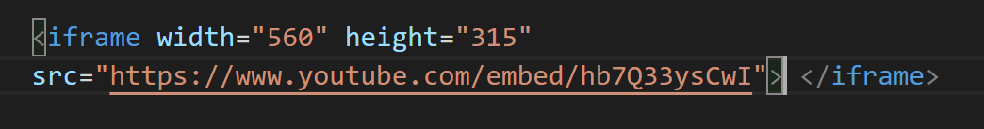
IFRAME
An inline frame is used to embed another document within the current HTML document.
It is typically used to load a youtube video into your web page

Slide 103
THE END

